Slide 1
Credit card fraud detection system
By : sudarshan singh
229303433

Slide 2

introduction
Credit card fraud is a significant problem, with billions of dollars lost each year. Machine learning can be used to detect credit card fraud by identifying patterns that are indicative of fraudulent transactions. Credit card fraud refers to the physical loss of a credit card or the loss of sensitive credit card information. Many machine learning algorithms can be used for detection. This project proposes to develop a machine-learning model to detect credit card fraud. The model will be trained on a dataset of historical credit card transactions and evaluated on a holdout dataset of unseen transactions.

Slide 3
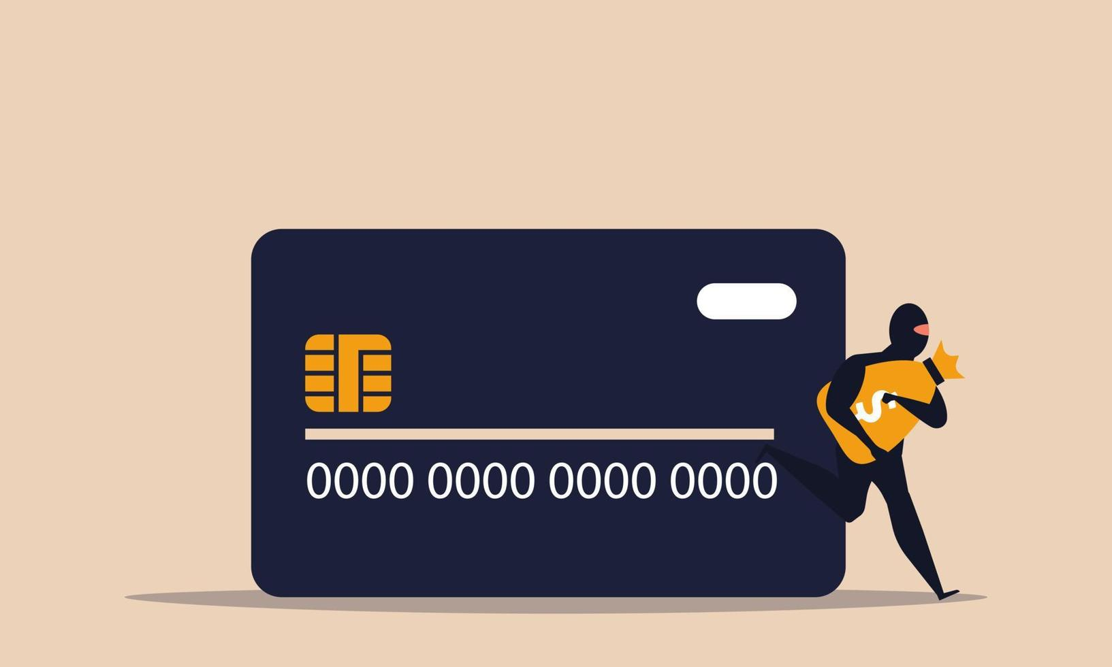
Overview
the number of people using credit cards worldwide was 3 billion in 2022 and increasing
There are two kinds of credit card fraud, and the first is having a credit card account opened under your name by an identity thief.
The second type is when an identity thief uses an existing account you created, usually by stealing the information on the credit card.
The statistics of these frauds caught our attention as the numbers have increased drastically and rapidly throughout the years, which motivated We to resolve the issue analytically by using different machine learning methods to detect fraudulent credit card transactions within numerous transactions.

Slide 4
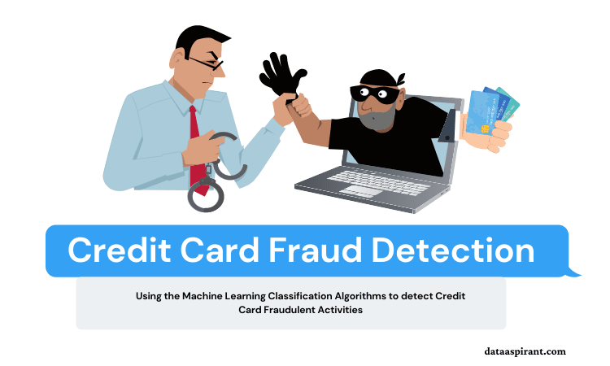
Project goals
The main aim of this project is the detection of fraudulent credit card transactions, as it is essential to figure out the fraudulent transactions so that customers do not get charged for the purchase of products that they did not buy.
Fraudulent Credit card transactions will be detected with multiple ML techniques. Then, a comparison will be made between the outcomes and results of each method to find the best and most suited model for detecting fraudulent credit card transactions; graphs and numbers will also be provided.
In addition, it explores previous literature and different techniques used to distinguish Fraud within a dataset.

Slide 5
algorithm
K-Nearest Neighbor (KNN)
Logistic Regression (L.R.)
Support Vector Machine (SVM)
Decision Tree (D.T.)

Slide 6

Future work
There are many ways to improve the model, such as using it on different datasets with various sizes and data types or by changing the data splitting ratio and viewing it from a different algorithm perspective.
An example can be merging telecom datato calculate the location of people to have better knowledge of the location of the card owner while his/her credit card is being used; this will ease the detection because if the card owner is in Dubai and a transaction of his card was made in Abu Dhabi, it will easily be detected as Fraud.

Slide 7
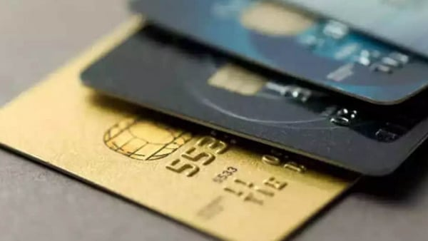
conclusion
In conclusion, the main objective of this project was to find the most suited model for creditcard fraud detection in terms of the machine learning techniques chosen for the project.
the best in terms of accuracy is KNN and Decision Tree, which scored well on credit card fraud and increased the customer’s satisfaction as it will provide them with a better experience and feeling secure.

